Slide 1
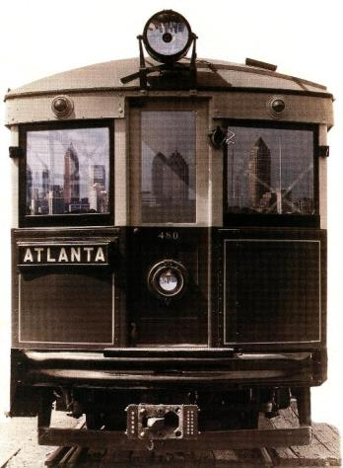
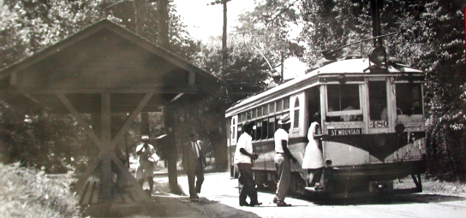
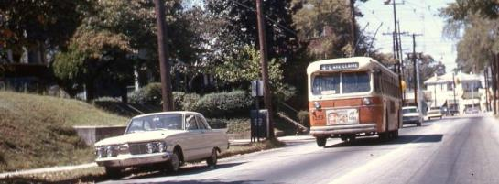

Transit in Atlanta – Past, Present, and Future
Electric Railroaders Association Conference
July 3, 2017

Slide 2
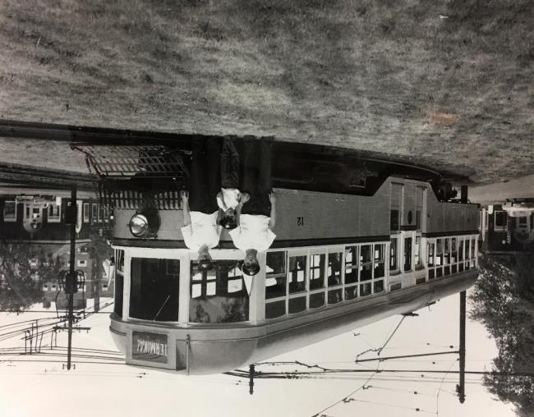
About Me

Slide 3
The Early Years
1861 Atlanta Street Railway starts first mule-powered street railway. Over a dozen street railways are incoroporated in the following 30 years.
1889 Atlanta & Edgewood Street Railroad Co begins operation of the city’s first electrified line.
1890s Major consolidation begins. The Atlanta Consolidated Street Railway and Atlanta Rapid Transit Company begin the “Second Battle of Atlanta.”
1901 All streetcar operations are consolidated into the Georgia Railway & Electric Company (today’s Georgia Power).
Notes:
The Atlanta & Edgewood Street Railroad alignment is currently operated on by the Atlanta Streetcar along Edgewood Ave.
It helped create Atlanta’s first suburb, Inman Park.
The Atlanta & Edgewood operated from Five Points in downtown to another five-point intersection – today’s Little Five Points.

Slide 4
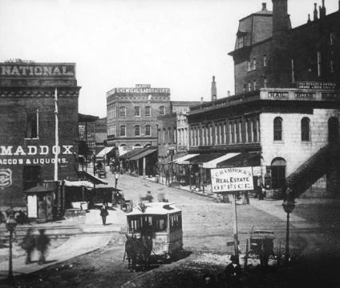
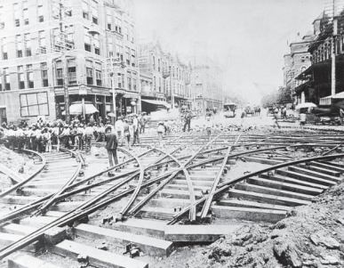
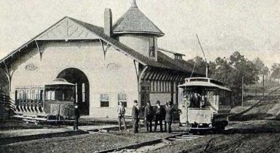
The Early Years
Above: a mule car on Peachtree St in 1872. At the location of today’s Five Points Station.
Upper Right: Track construction at Five Points, 1891.
Right: Atlanta & Edgewood Street Railroad car barn on Edgewood Ave circa 1894. The building still stands today as an event facility.
Photo credits: Railga.com, New South Construction
Notes:
Unlike a lot of northern towns that used horses before electrification, Atlanta used mules because they were better suited to the hot, humid summers.
Because Atlanta’s railroad junction was in the heart of the city, trains at depots (including the original Union Station) caused a huge backup on the streets. This inconvenience led to a series of massive projects to grade-separate downtown streets from the railroads, and eventually created Underground Atlanta and the area known as The Gulch.
The Atlanta & Edgewood used the Van Depole electrification system.
You can visit the Atlanta & Edgewood car barn in that neighborhood – we’ll get to that later.

Slide 5
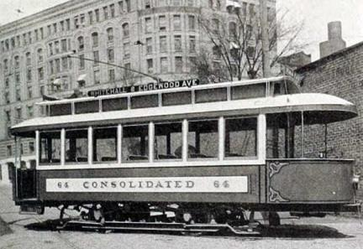
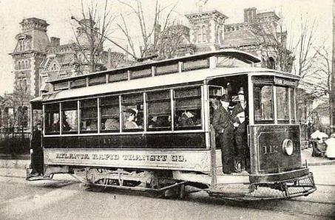
Second Battle of Atlanta
Two feuding figures: Joel Hurt and Henry M. Atkinson
Built competing lines blocks away, created legal obstructions, vandalized each other’s tracks; even rumors of a duel.
Hurt’s Atlanta Consolidated Street Ry ultimately merged into Atkinson’s Atlanta Railway & Power Co, forming Georgia Railway & Power (GR&P).
Photo credits: Railga.com, New South Construction
Notes:
The second battle of Atlanta was about not just streetcars, but also real estate and power interests.
It became more than a corporate feud, and was a personal one between the two men.

Slide 6
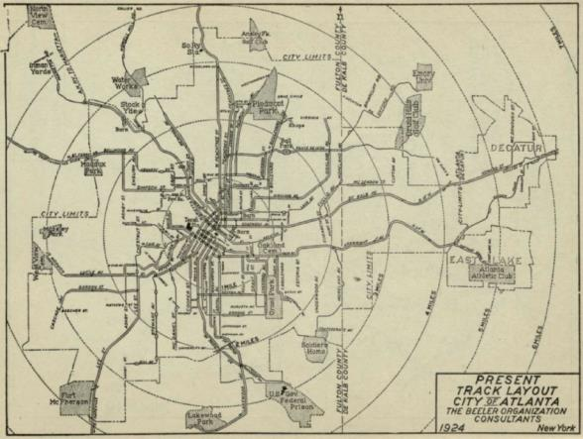
The Georgia Power Years
Period of Expansion and Improvement
System trimmed after the “Second Battle of Atlanta”
Profitable routes double-tracked
New interurban lines to suburbs
1924 – 200 miles, 404 streetcars
1925 - start of bus operations
1930 - start of one-man operations
Photo credits: Beeler Report
Notes:
Immediately after the Second Battle was won, the system was streamlined.
Streetcar ridership peaked in the 1920s.
A massive investment that updated equipment and rolling stock to modern standards prepared the system for the Great Depression and the stresses of the high-ridership war years.
Even in the early years, the system operated beyond the City of Atlanta to neighboring suburbs – Decatur, Hapeville, Marietta – resulting in franchise agreements with multiple municipalities.
Until MARTA began operating, separate fare structures existed for Decatur with roots in these agreements.
The agreement with Decatur required Georgia Power to maintain a 5-cent fare and two man operation; Decatur cars had a different paint scheme with yellow triangles near the doors.

Slide 7
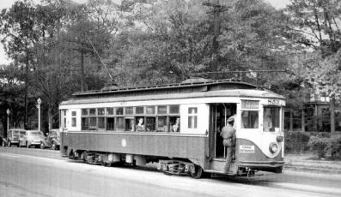
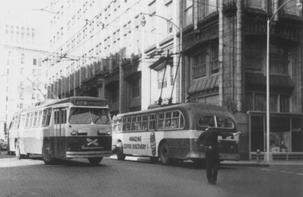
The Georgia Power Years
Challenges and Change
1936 First bus substitutions
1937 Trackless trolleys introduced
1940s WWII delayed trackless conversion plans, cut buses, and increased streetcar use
1945 First air-conditioned trackless trolley, ridership of 150,964,244
1946 Start of wide streetcar/ trackless trolley conversions
1949 Last streetcar run
Top: A streetcar on the #5-Highland/S Pryor line.
Bottom: Trackless trolleys in downtown.
Photo credits: Rich Krisak Collection
Motor Coach Age Magazine
Jan/Mar 1997 and July/Sep 1998
Notes:
Georgia Power developed a specification for a double-ended PCC car, and was a member of the ERPCC.
While they helped develop the standards, their interests in power over rail led them to convert the transit system to trackless trolleybus and begin a program of expansion.
The last batches of the St Louis trolleybuses ordered by Georgia Power – the ones you saw today at the museum – are unique to Atlanta, and are the closest thing created to a trackless trolley PCC.

Slide 8
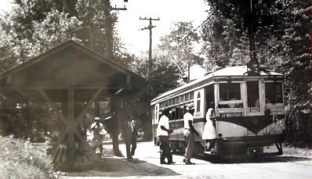
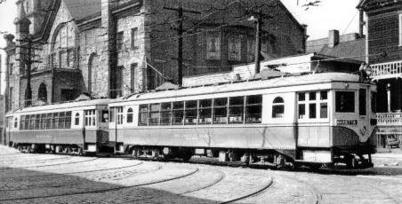
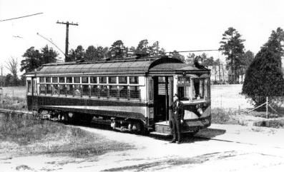
The Georgia Power Years
Above: Georgia Power interurbans signed for Marietta sit in front of the Butler Street car barn.
Top left: A Stone Mountain interurban car boards passengers at a waiting shelter.
Bottom left: Stone Mountain interurban car.
Photo credits: Rich Krisak Collection
Notes:
The South wasn’t known for its interurbans, save for Dallas and parts of South Carolina. Atlanta was an exception, with three lines – though one is debatable, as it was operated with City equipment. Interurban service ran to Stone Mountain, Marietta, Hapeville, and College Park.
Interestingly, the Atlanta Northern to Marietta originally operated with an AC traction system independent from the city system, unlike most lines at the time.
When the interurbans were modernized in the 1920s, Cincinnati Car Co “curvesiders” were purchased and included rapid-transit style couplers, sliding pocket doors, safety systems preventing train operation with open doors, and multiple-unit control (even multiple-unit door control).
** The title slide clearly shows the coupler and end doors designed for multiple units.

Slide 9
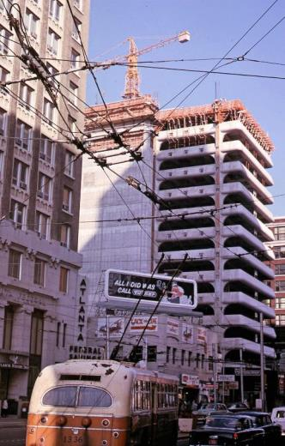
The Atlanta Transit Years
1950 37-day strike. Georgia Power sells its transit operation to the new Atlanta Transit Company.
1951 ATC acquires suburban bus company, unifying the system
1950s ATC reorganized into the Atlanta Transit System (ATS), expands use of trolleybuses.
1960 ATS starts promoting rapid transit
1961 First proposed rapid transit plan
1963 Last trackless trolley run
1965 MARTA is created
Photo credits: Rich Krisak Collection
Notes:
Georgia Power was already struggling with an increasingly unprofitable enterprise - especially after accumulating trust agreements from the expansion of the trackless trolley network. There were loans to pay, declining ridership, and the inability to raise fares due to local politics.
The Securities & Exchange Commission’s decision to force power monopolies to divest their transit operations came shortly before the 1950 strike, which marked the system’s end under Georgia Power - the company was sold to the Atlanta Transit Company during the strike, so employees came back to work for a new owner.
Up to the very end, the Atlanta Transit System was investing in trackless trolleys.
It wasn’t the economics of operation that killed the trackless trolley, but freeway construction and one-way street conversions.
The resulting costs of rewiring became too much to bear, and GMAC – General Motors’ financing arm – offered to take the copper wire as trade-in for brand-new diesel New Look buses. You saw one of these at the museum today.

Slide 10
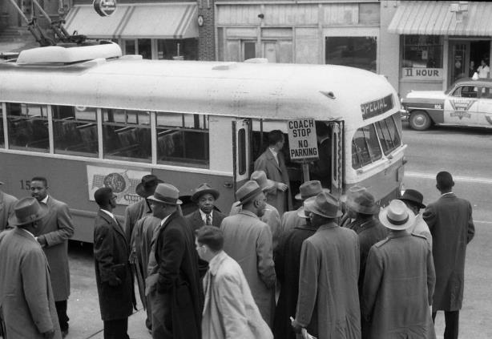
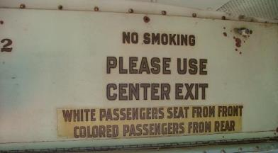
Desegregation
Followed Montgomery bus boycott
Civil rights leaders planned to secure a test case in court
January 9, 1957 – Rev William Holmes Borders leads a group to board a trolleybus
Notified mayor in advance and took measures to avoid civil unrest
Ruling delivered on January 9, 1959 – desegregated system citing Montgomery
January 20, 1959 – first day of desegregated service

Slide 11
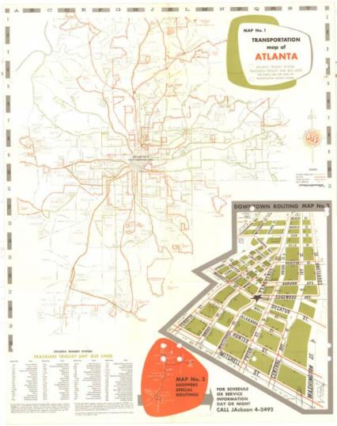
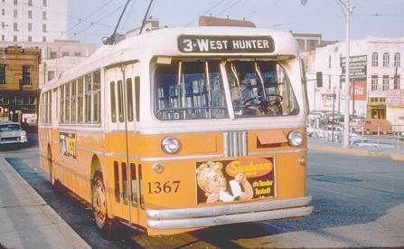
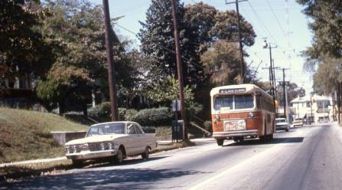
The Atlanta Transit Years
Photo credits: Tarrence Brown,
Rich Krisak Collection,
MARTA Historical Collection
Notes:
Initially, the relationship between Atlanta Transit and MARTA was hostile, with Atlanta Transit pushing opposing rapid transit plans.
When Atlanta Transit managers realized the profits to be made if they were bought out by MARTA, this faded.
Among employees who transitioned, there were growing pains as they integrated into the new organization. An example was the ATS Christmas ham – an annual tradition wherein management gifted a ham or turkey to all employees. Cautious with the use of its new taxpayer dollars, MARTA ended the practice, upsetting a number of ATS employees who were uncomfortable in the new agency culture.

Slide 12
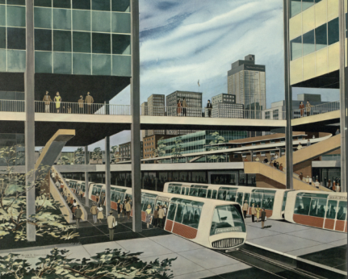
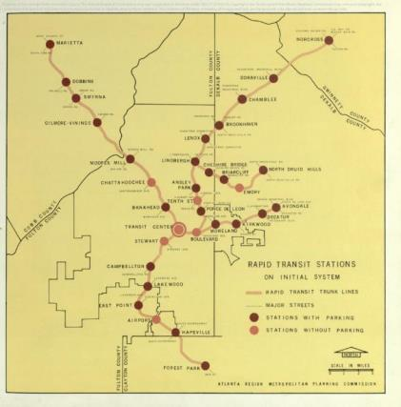
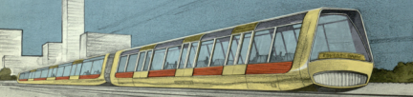
Planning Advances in the 1960s
Maps and illustrations from 1961’s “Atlanta Region Comprehensive Plan: Rapid Transit”
Image credits: MARTA Collection
Notes:
The Atlanta Regional Metropolitan Planning Commission (now ARC, the regional planning commission) began pushing rapid transit plans in the early 1960s.
These images show a very early conceptual system, along with its modern new look.
One train in the upper left image is signed for Marietta, where this system’s northwest line would have ended – roughly following the path of the former interurban.
The “Transit Center Station” shown in the photo is in the vicinity of Atlanta’s original Union Station.

Slide 13
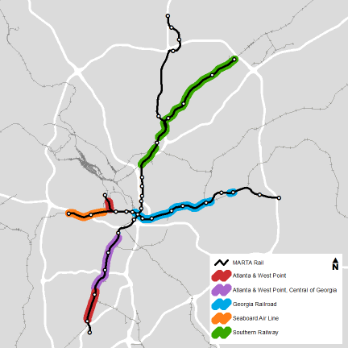



Planning Advances in the 1960s
ATS proposed first rapid transit plan
Metropolitan planning agency proposed additional plans before MARTA took the lead
ATS briefly advanced a busway plan in competition with MARTA
Rapid transit plans generally followed existing railroad corridors
Image credits: MARTA Planning
Notes:
Similar to WMATA and BART, MARTA engineers at the time tried to save on right-of-way costs by designing the system along existing railroads.
But there was a trade-off: these rights-of-way bypassed many activity centers and neighborhood districts, requiring bus transfers or extensive walks.
Key exceptions were designed into the system: a central subway through downtown and midtown Atlanta, as well as one in Decatur.

Slide 14
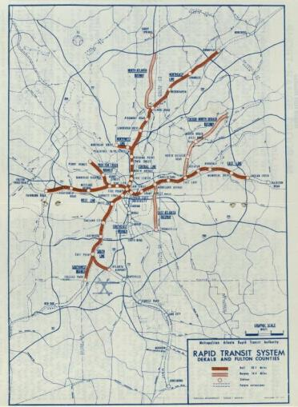
MARTA is Created in 1965
The new authority is charged with a broad mission.
MARTA was created to plan, design, construct, and operate 5-county transit system
Rapid transit and bus system plans were developed
Referenda held in 1971; two counties join (Fulton, DeKalb)
Referendum defeated in Clayton and Gwinnett; Cobb does not vote
Clayton eventually joins in 2014
Image credits: MARTA Historical Collection
Notes:
MARTA advanced a rail-only referendum in 1968 that failed, caught between the tense racial politics of the day and resentment from suburban voters unwilling to pay the property tax increase.
After the defeat, MARTA regrouped and proposed a revised system, coupled with a major 5-year bus improvement plan and a 10-year reduction in fares to 15 cents.
A 1971 vote saw two counties join; other counties were cut out of the rapid transit system plan.
The South Atlanta and Tucker-North DeKalb busways were designed to operate on freeways that were never built, cancelled after prolonged organized opposition by local neighborhood groups.
The Inman Park Station is a remaining vestige of these plans, with limited entrances and nearby Freedom Park, which was built on the abandoned freeway property.
Other provisions for unbuilt lines exist in a trench and tunnel portals near East Lake Station, interesting track geometry near East Point Station, and empty tunnels branching off north of Arts Center Station.

Slide 15
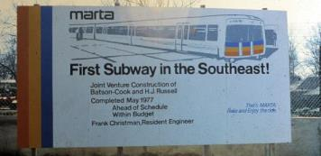
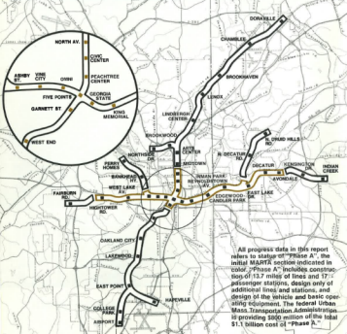
MARTA’s Construction Years
MARTA purchases the Atlanta Transit System in 1972 and implements a 5-year bus improvement plan
Groundbreaking for Phase A in February 1975 on the East Line
Phase A – Avondale to H.E. Holmes, North Ave to Garnett
Largest regional public works project in the southeast since the TVA
Photo credits: MARTA Historical Collection
Notes:
The first subway in the southeast was built through downtown Decatur, which opened with the system’s first segment in 1979.
MARTA’s Phase A construction effort would last until 1982, and would construct much of today’s Blue Line and a portion of the downtown Atlanta subway.
MARTA was a mammoth effort for Atlanta. It was proclaimed to be the largest regional public works project since the TVA.

Slide 16
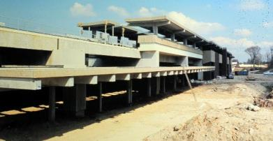
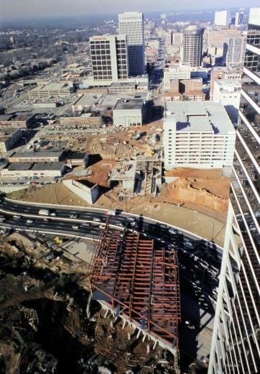
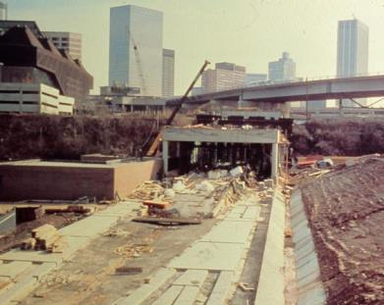
MARTA’s Construction Years
Photo credits: MARTA Historical Collection
Notes:
Scenes from Phase A rail construction.
At top left: H.E. Holmes Station under construction.
At bottom left: construction at the Omni (now Dome) Station. The station box is visible at rear, under the soaring Techwood Dr viaduct. In the foreground, direct fixation structures for the pocket track are visible.
At right: construction at the Civic Center Station. The station bridges over the Downtown Connector, which was temporarily re-routed out of construction’s way as the southern half of the bridge was built. The highway was subsequently widened to fill the entire space under the bridge.

Slide 17
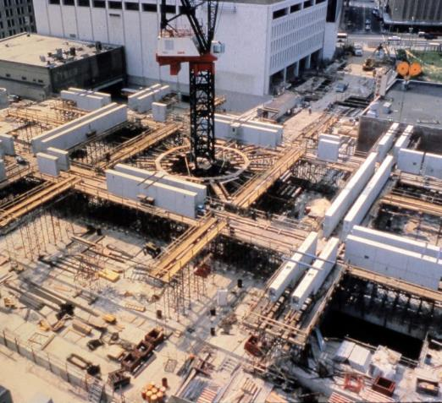
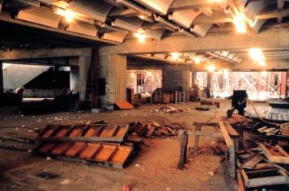
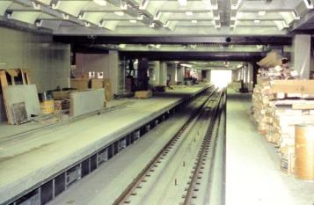
MARTA’s Construction Years
Photo credits: MARTA Historical Collection
Notes:
Scenes from Five Points Station construction.
At left: construction of the Five Points roof and oculus.
Top right: early construction of the East/West platform level, possibly from the area of the Eastbound outside platform.
Bottom right: the nearly-complete eastbound platforms and tracks.

Slide 18
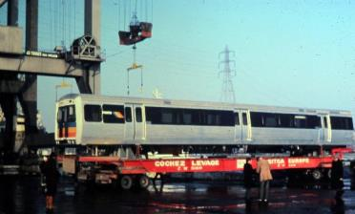
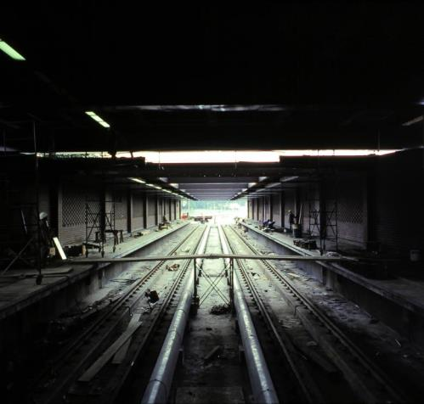
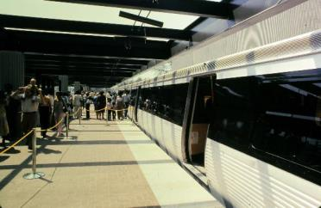
MARTA’s Construction Years
Photo credits: MARTA Historical Collection
Notes:
While MARTA rail construction was underway, the first railcar order was built in France by Societe Franco-Belge.
Top left: Car 101 is loaded onto a barge in France.
Bottom left: a train is shown to the public as a preview at the still-unfinished Avondale Station.
Right: Finishing work is done at the Inman-Park/Reynoldstown Station.

Slide 19
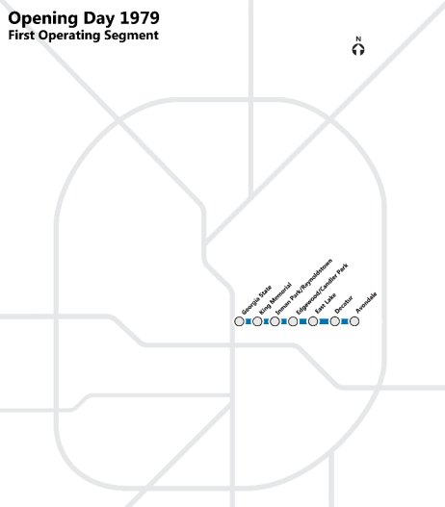
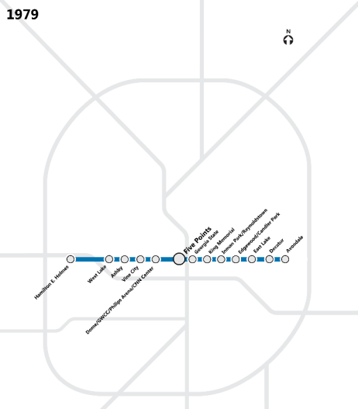
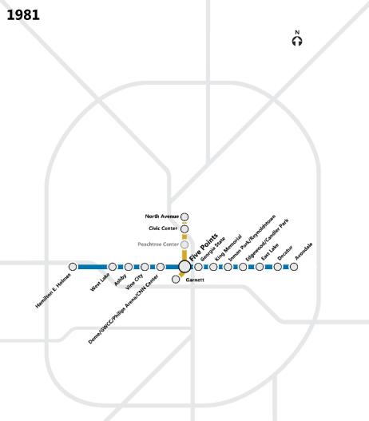
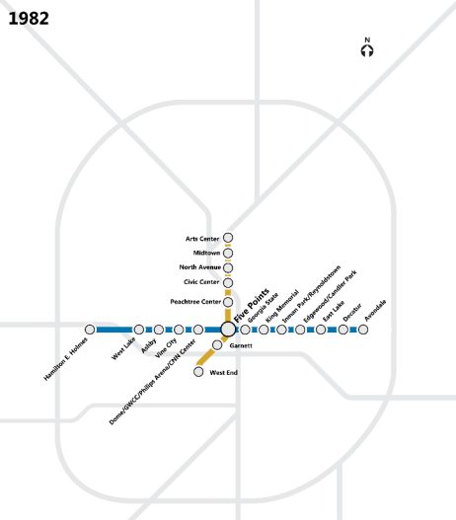
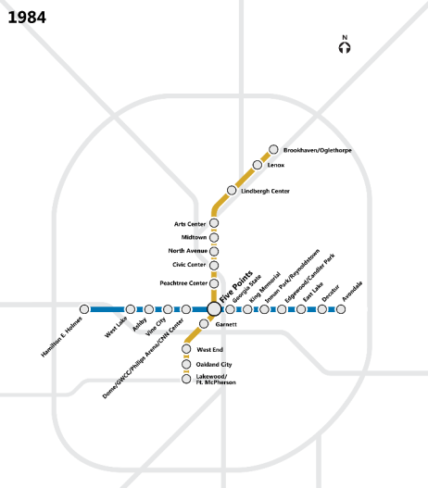
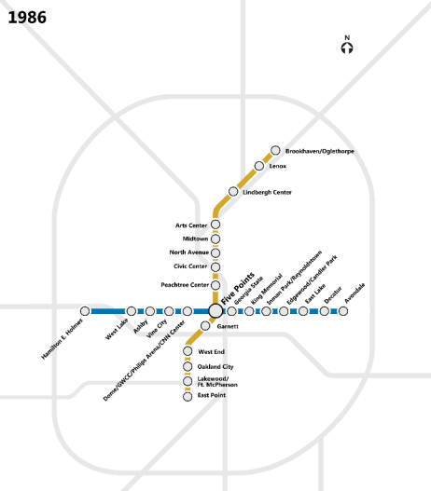
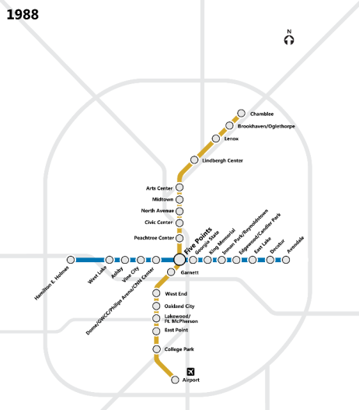
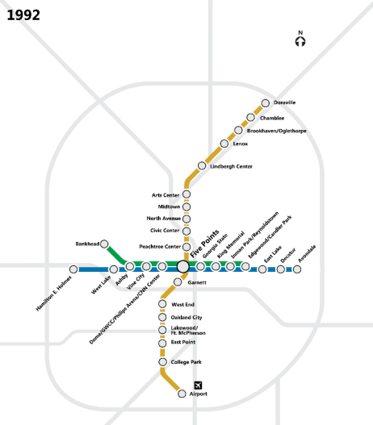
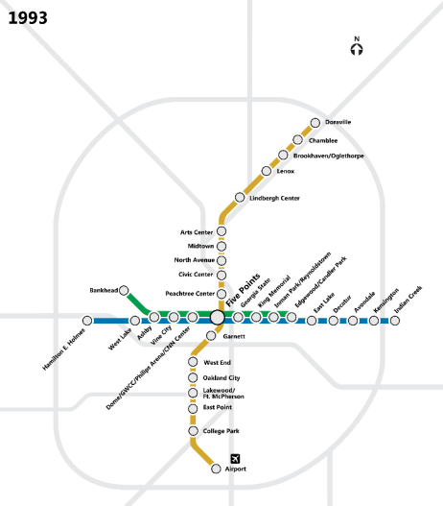
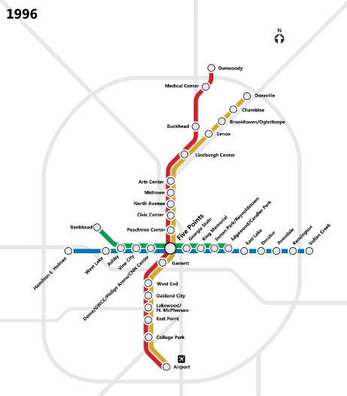
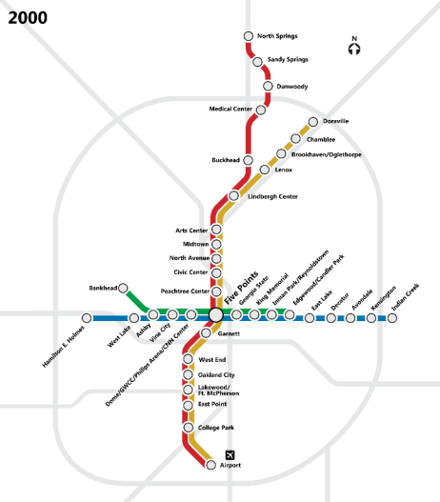

Startup and Expansion
Rail service began June 1979
Reached the airport in 1988
North Line was planned as a busway, but was built as heavy rail for the ‘96 Olympics
Last heavy rail extension in took place in 2000
Clayton County joined MARTA in 2014, bus service began in March 2015
Image credits: MARTA
Notes:
The system opened on June 30, 1979 and continued expanding for two decades.
A number of staff including the GM left for Houston after the system opened.
Changes to the 1971 plan included the conversion of the North Atlanta Busway, which was ultimately built as a heavy rail extension in a highway median. It’s now the Red Line to North Springs.
Clayton County, which opted not to join MARTA in 1971, voted to join the system in 2014. Bus service was rolled out within months, and a long-range planning effort was started. More on that later.

Slide 20
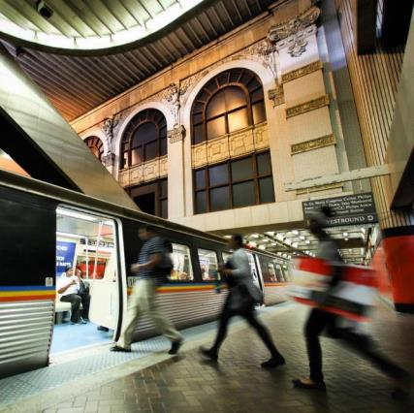
MARTA Today
Rail System
104 track miles
  21 miles in tunnel
  24 miles elevated
  58 miles at grade
38 stations
Automatic train control (ATC)
3 rail yards
316 rail cars
Photo credits: MARTA
Notes:
System demographics:
Annual household income – 87.3% under $75,000
Gender – 46.1% female, 53.9% male
Race – 75.3% African-American, 15.8% white, 8.9% other
Ethnicity – 5.7% Spanish/Hispanic/Latino, 94.3% not
School - 31.2% high school degree or under, 52.3% part or complete bachelor’s degree, 9.5% grad/post-grad
Age - 3.5% 65 or older, 71.7% 25-64 years, 24.7% 16-24
85.7% live in service area, 14.3% out of district

Slide 21
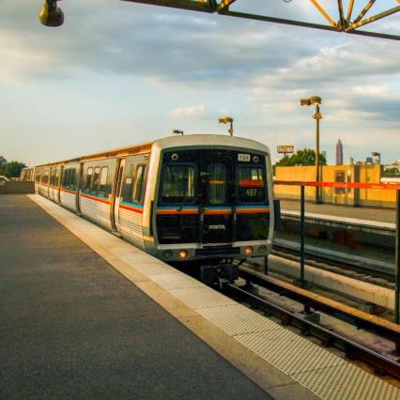
MARTA Today – Rolling Stock
CQ310 Cars
96 cars
Societe Franco-Belge
Delivery in 1979
Beyond useful life
Contains asbestos
Below average reliability
Carshell cracks have been repaired
Obsolete systems include doors, HVAC
Photo credits: MARTA

Slide 22

MARTA Today – Rolling Stock
CQ311 Cars
120 cars
Hitachi
Delivery in 1985
Below average reliability
Truck issues
Carshells beyond useful life
Obsolete systems include auxiliary power, HVAC, signage
Photo credits: MARTA

Slide 23

MARTA Today – Rolling Stock
CQ312 Cars
100 cars
Breda
Delivery in 2002
Well below average reliability (borders on worst in industry)
Carshell and truck issues
Obsolete systems include automatic train control, auxiliary power, signage, doors
Photo credits: MARTA

Slide 24



MARTA Today – Current Projects
New Rail Fleet
250 cars
Possible new features include:
Open to alternatives to married pair configuration
Tri-pod stanchions
New ADA provisions
Open to new interior layouts
New interior signage systems with variable messaging
Photo credits: BART, TTC

Slide 25


MARTA Today – Current Projects
Train Control & SCADA Upgrade
New centralized platform for integrated systems
  Train control, SCADA, communications, fire systems, audio/visual, and more
New field equipment installed - SCADA, communication, train control systems
Upgraded interfaces on trains
New central office system at the Integrated Operations Center
Photo credits: MARTA
Notes:
Largest brownfield signaling project in the country

Slide 26


MARTA Today – Current Projects
Integrated Operations Center (IOC)
TCSU project required upgraded facilities
Integrates Rail, bus, Mobility, and police communications
27,000 square feet in former railcar maintenance facility
Raised flooring, display wall, focus on ergonomics and acoustics
Image credits: MARTA Architecture

Slide 27


MARTA Today – Current Projects
Emergency Operations Center (EOC)
Located in IOC building
8,000 square feet
Dedicated conference space for MARTA management
Breakout rooms, large display boards
Shared media room for holding press events
Image credits: MARTA

Slide 28


MARTA Today – Current Projects
Signage Transformation
Current Signs
Total count: 155
Decommissioning 15
Provides limited information
Majority on the platform level
New Signs
Total count: 320+
Provides variety of information
At entrances and on the concourse and platform level
Image credits: MARTA

Slide 29


MARTA Today – Current Projects
Audio Transformation
Replace
4,000
speakers
Add
500
speakers
Synchronize
with
signage
Ambient
sensors to
adjust volume
Image credits: MARTA

Slide 30


MARTA in the Future
I-20 East Transit Initiative
Provides direct link from south DeKalb County to downtown Atlanta
Two projects:
  Bus rapid transit from Five Points to Wesley Chapel
  Heavy rail extension to Mall at Stonecrest
Bus Rapid Transit
Heavy Rail
Image credits: MARTA Planning
Notes:
The I-20 East transit initiative includes two parts.
The first is a bus rapid transit line from downtown Atlanta to Wesley Chapel Rd in DeKalb County.
The second is a heavy rail extension from Indian Creek to Stonecrest Mall, near the DeKalb/Rockdale County line.
This will provide a direct link to south DeKalb County from downtown Atlanta, and connect south DeKalb to Decatur and other areas in the county.

Slide 31

MARTA in the Future
GA 400 Transit Initiative
Expanded high-capacity service along GA-400 into North Fulton County to Windward Parkway in Alpharetta
Considering heavy rail, bus rapid transit
5 new stations
Image credits: MARTA Planning
Notes:
The GA-400 project would expand a high-capacity service along the highway corridor into North Fulton County as far as Alpharetta.
Heavy rail and bus rapid transit are being considered.
This would add 5 stations to the system.

Slide 32


MARTA in the Future
Clifton Corridor Transit Initiative
Provides new light rail service to Clifton Corridor from Lindbergh Center to Avondale
Emory University and related hospitals, Centers for Disease Control
New high-capacity transit option for an area without nearby freeway or MARTA rail access
Several alternatives are under consideration
Image credits: MARTA Planning
Notes:
The Clifton Corridor Transit Initiative provides new light rail service between Lindbergh Center and Avondale.
This line would serve major employers in the area – Emory University, Centers for Disease Control, Children’s Healthcare, and more.
Notably, the employers are clustered in the central part of the proposed lines, without convenient freeway access or MARTA rail service. This line would add a new high-capacity option.
Several alternatives are still under consideration.
Interestingly, Emory University has started making moves to be annexed into the City of Atlanta, whose recently-passed MARTA sales tax might then be applied towards construction of this line.

Slide 33


MARTA in the Future
Clayton County Transit Initiative
Study initiated after Clayton County joined MARTA in 2014
Explores different transit alignments and technologies
Connection between Lovejoy and MARTA rail on South Line at East Point or College Park
Considering light rail, bus rapid transit
Image credits: MARTA Planning
Notes:
After Clayton County joined MARTA, long-range planning began immediately.
The Clayton County initiative is currently exploring multiple technologies and alignments.
One follows the Central of Georgia line used by MARTA’s South Line all the way to Lovejoy.
Several rail options and bus rapid transit are under consideration.

Slide 34

MARTA in the Future
More MARTA
In 2016, City of Atlanta voted 71% for an addition ½-cent to MARTA
A mix of high-capacity and bus improvement projects considered:
  Light rail routes
  Clifton Corridor light rail
  Northside Dr, I-20 East BRT
  I-20 West heavy rail
  Station enhancements
  Infill stations and new transit centers
  5 arterial rapid transit bus routes
  Improved bus span and frequency
Image credits: MARTA Planning
Notes:
Recently, the City of Atlanta voted 71% in favor of dedicating an additional ½ cent to MARTA.
This money will be used to fund projects from a list of projects.
Projects include light rail, bus rapid transit, heavy rail, station enhancements, infill stations and new bus transit centers, and bus improvements.

Slide 35



MARTA in the Future
More MARTA
Implemented already:
  Frequency improvements
  Wider hours
  Circulator routes
New system design based on different service types
Goals to improve operations efficiency, attract choice riders, develop sustainable service plans
Image credits: MARTA Planning
Notes:
Recently, the City of Atlanta voted 71% in favor of dedicating an additional ½ cent to MARTA.
This money will be used to fund projects from a list of projects.
Projects include light rail, bus rapid transit, heavy rail, station enhancements, infill stations and new bus transit centers, and bus improvements.

Slide 36

Historical Sightseeing
Points of Interest
Edgewood Ave car barn 963 Edgewood Ave NE
Ashby St car barn 981 Joseph E Lowery Blvd NW
Streetcar waiting shelter Ponce de Leon Ave NE & E Lake Rd NE
Trolley Line Trail (private ROW) Woodbine Ave NE & Wade Ave NE
Exposed tracks Whitefoord Ave SE & Arkwright Pl SE McLendon Ave NE & Clifton Rd NE
Trolley poles Downtown, Ponce City Market, all over
2
6
3
5
6
1
4
5
Image credits: MARTA
Notes:
Before we go: there are a number of places where you can see remnants of the city’s transit history.
The Edgewood Ave car barn still stands in beautiful condition. You can take MARTA to the Inman Park Station, exit to Edgewood Ave on the north side, and walk two blocks.
The Ashby St car barn also still stands, and has been converted into part of an arts center. This is a short drive from West Midtown, a former industrial corridor that now has lots of restaurants and shops.
A streetcar waiting shelter remains at the intersection of Ponce de Leon Ave & East Lake Rd, near Atlanta’s leafy and majestic Druid Hills neighborhood.
The Trolley Line Trail showcases a former private right-of-way along a string of neighborhoods shaped by the streetcars. It’s not far from the Candler Park Station on MARTA’s #24 bus route.
Exposed tracks are evident in several places – one not far from the Trolley Line Trail, and another in the Candler Park commercial district.
Trolley poles are visible all over the city if you look closely. A nice row exist in front of Ponce City Market, an exciting re-use of Atlanta’s old Sears & Roebuck warehouse – a great place for dinner or a drink. They’re also visible around downtown, and at intersections around many of the city’s inner suburbs.

Slide 37
References
Books & Magazines
Mule to MARTA, Vol I & II – Jean Martin, 1977
The Trolley Titans – O.E. Carson, 1981
Motor Coach Age Magazine – Jan ‘97, July ‘98
Online
RailGA.com - http://railga.com/oddend/streetrail/atlantastr.html
MARTA Historical Collection at GSU - http://digitalcollections.library.gsu.edu/cdm/landingpage/collection/marta
Notes:
There are also great references if you want to learn more.
The Mule to MARTA, Trolley Titans, and Motor Coach Age magazines are usually available on Amazon or eBay.
The MARTA historical collection is a partnership between MARTA and Georgia State University, who has scanned and housed a number of historic planning documents in a permanent digital collection. This includes the complete 1968 and 1971 rapid transit plans, showing detailed right-of-way.
And RailGA.com is a great place to look for streetcar and other railroad history in our state.

Slide 38

Questions?
Notes:
There are also great references if you want to learn more.
The Mule to MARTA, Trolley Titans, and Motor Coach Age magazines are usually available on Amazon or eBay.
The MARTA historical collection is a partnership between MARTA and Georgia State University, who has scanned and housed a number of historic planning documents in a permanent digital collection. This includes the complete 1968 and 1971 rapid transit plans, showing detailed right-of-way.
And RailGA.com is a great place to look for streetcar and other railroad history in our state.

